Slide 1
TO BE FORMS-WAS AND WERE

Slide 2
TO BE FORMS-WAS AND WERE
Was and were are past forms of verb to be.
Was is used with I, he , she and it.
Were is used with we ,you and they.
We can make affirmative, negative and interrogative sentences with was and were.
subject+was/were+other words[affirmative]
subject+wasn’t /weren’t +other words[negative]
was/were+subject+other words[interrogative]

Slide 3
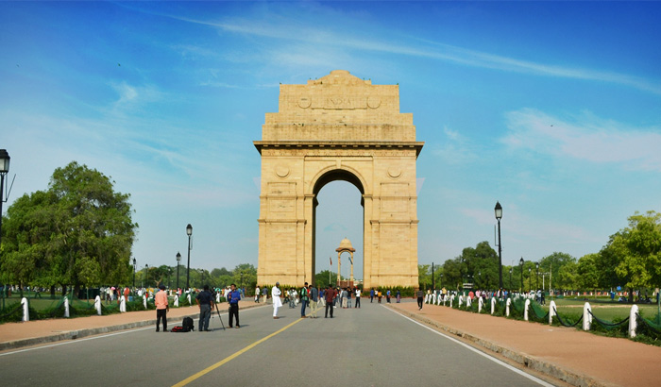

HOW TO USE WAS AND WERE IN ENGLISH?
Was and were can be used to talk about a location or position
of someone or something at a time in the past.
I was in Delhi last year. We were at home yesterday.

Slide 4
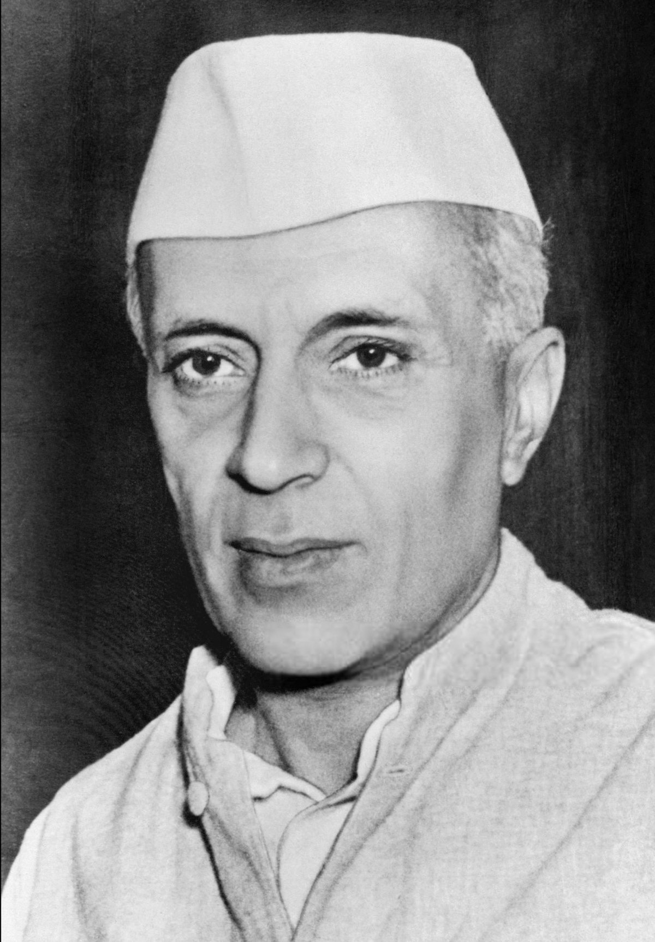
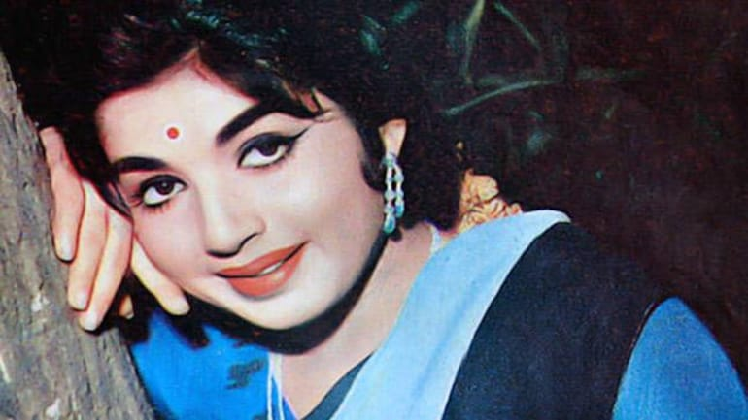
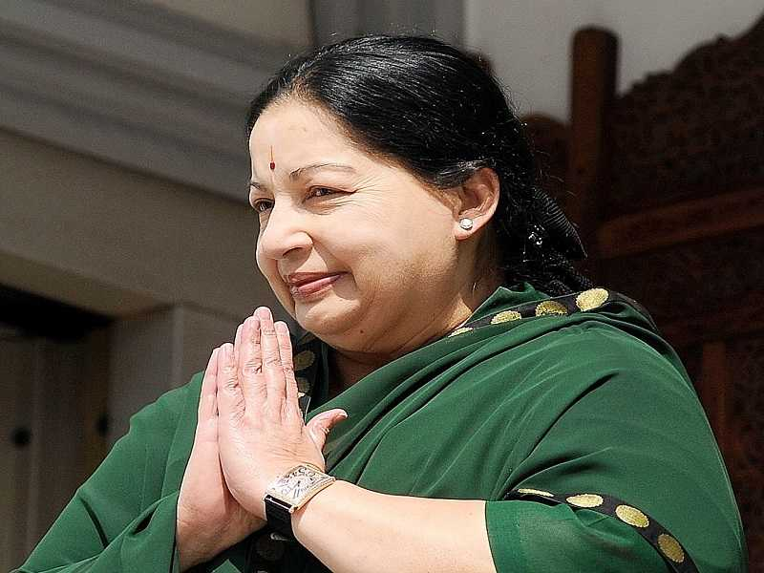
HOW TO USE WAS AND WERE IN ENGLISH?
Was and were can be used to talk about status in the past.
Nehru was the first PM of India. Jayalalitha was an actress before she became
a politician.

Slide 5


HOW TO USE WAS AND WERE IN ENGLISH?
Was and were can be used to talk about age, weight height
or number in the past.
I was 23 years old last year. I was 18 when I started driving.

Slide 6

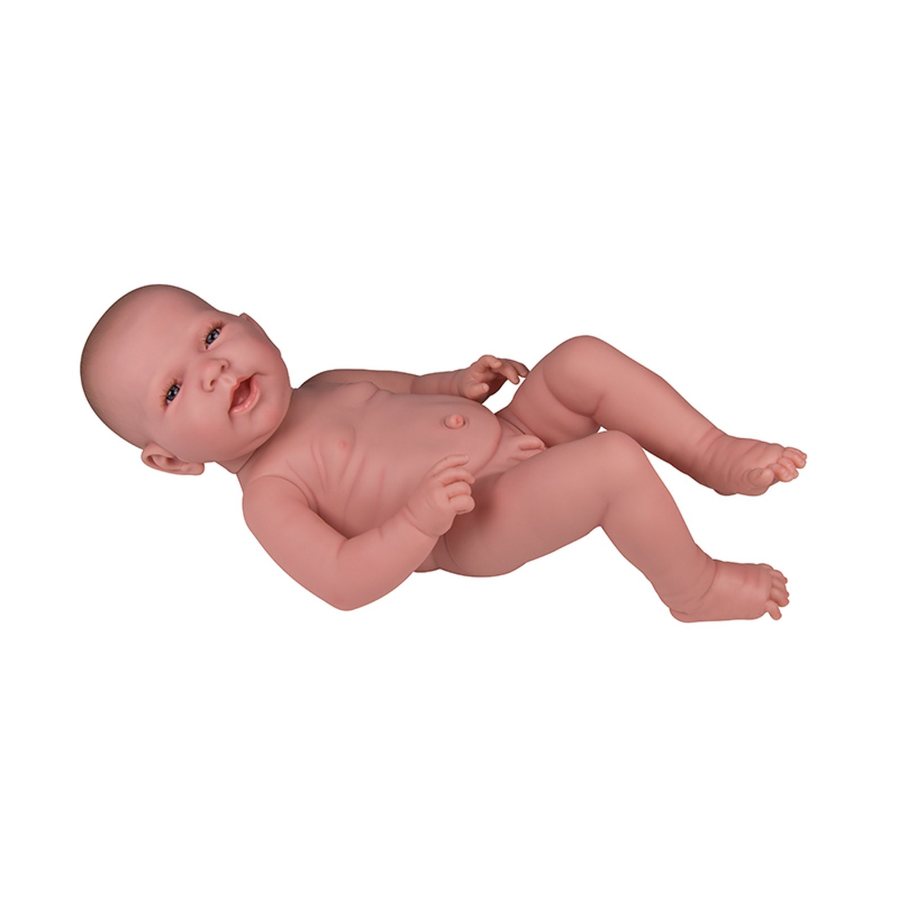
HOW TO USE WAS AND WERE IN ENGLISH?
The baby was just 2 kg when He was 21 when he got his first job.
she was born.

Slide 7


HOW TO USE WAS AND WERE IN ENGLISH?
I was just 4 feet 2 inches tall She was 24 when she got married.
when I was in 10th class.

Slide 8


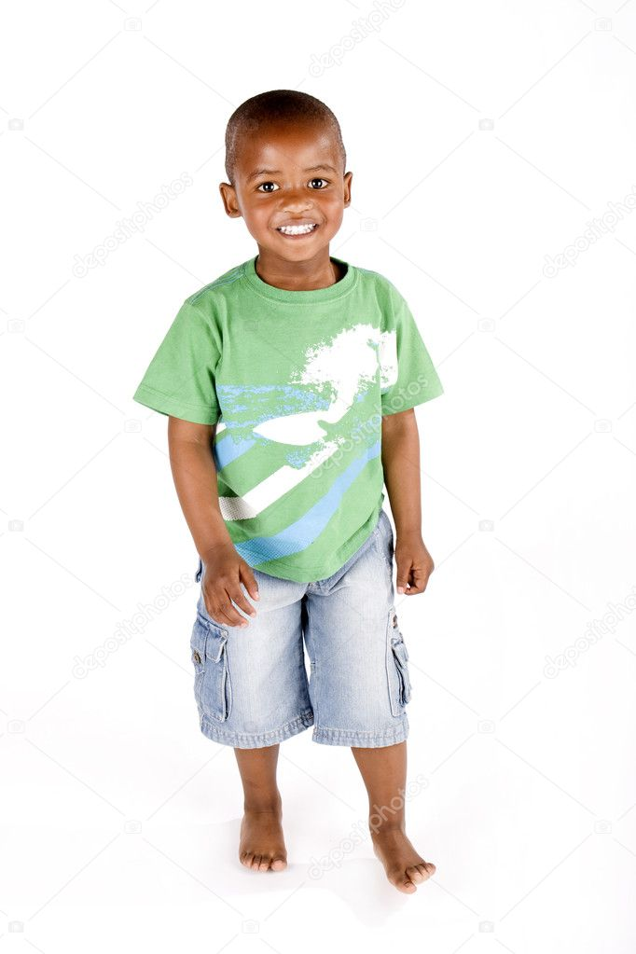
HOW TO USE WAS AND WERE IN ENGLISH?
I was just 11 years old when They were just 3 years old when they lost their
we moved to the city. father.

Slide 9
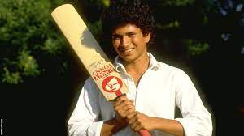
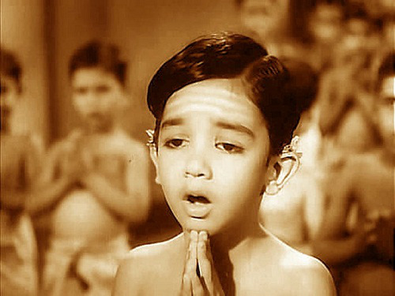
HOW TO USE WAS AND WERE IN ENGLISH?
Sachin was 15 when he started Kamalhasan was just 3 years old when he
playing cricket. started acting.

Slide 10
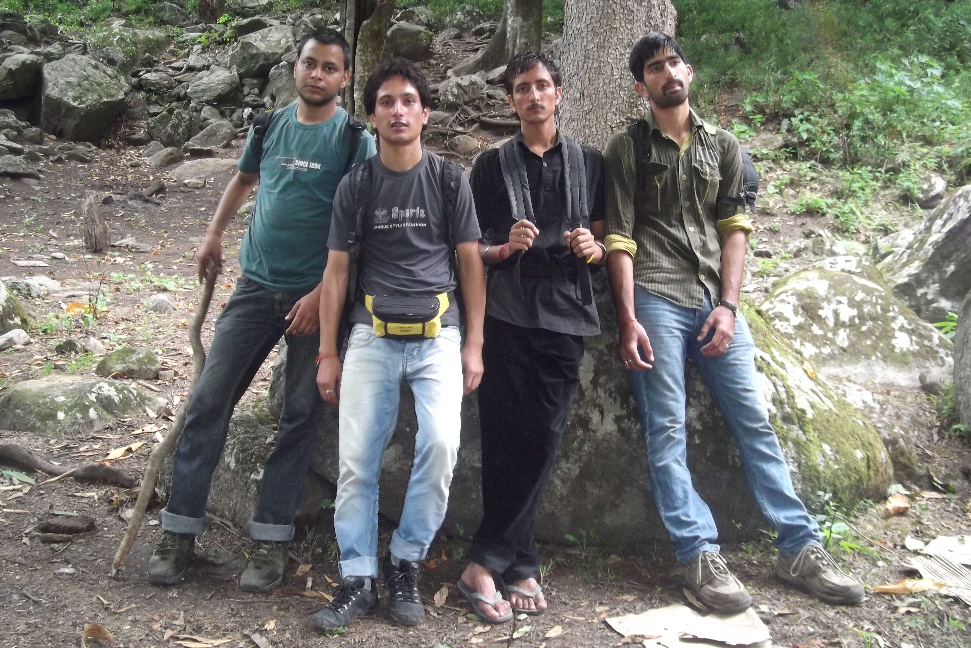

HOW TO USE WAS AND WERE IN ENGLISH?
Was and were can be used with a condition in the past.
We were very tired after the journey. He was busy yesterday.

Slide 11
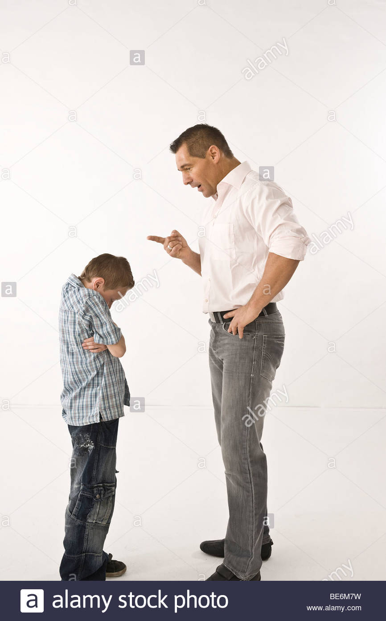
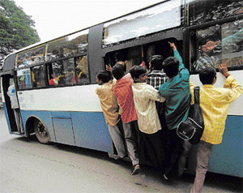
HOW TO USE WAS AND WERE IN ENGLISH?
My father was very angry The bus was crowded this morning.
with my marks.

Slide 12
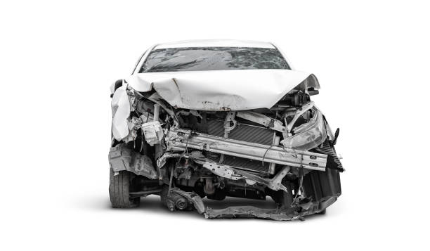
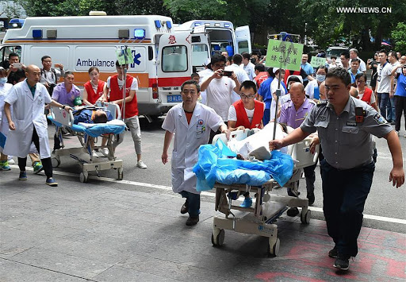
HOW TO USE WAS AND WERE IN ENGLISH?
Many people were injured in The car was badly damaged in the accident.
the accident.

Slide 13
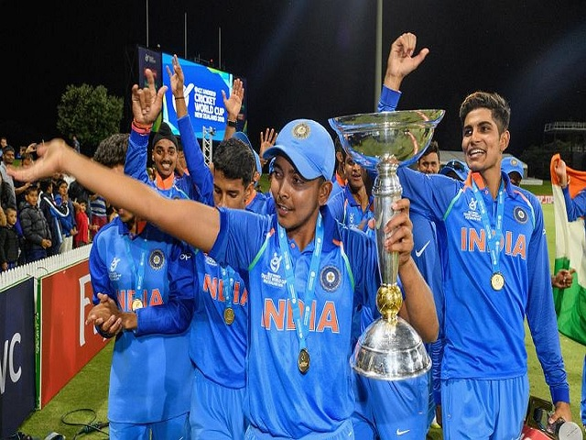

HOW TO USE WAS AND WERE IN ENGLISH?
Was and were are used with feelings or state of mind in the past.
We were happy because we won He was depressed after his wife’s death.
the match.

Slide 14
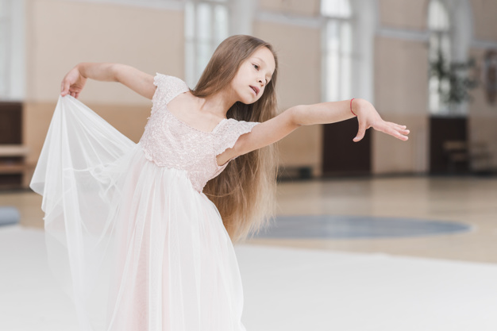

HOW TO USE WAS AND WERE IN ENGLISH?
I was interested in dance in We were shocked to hear the news.
my childhood.

Slide 15


HOW TO USE WAS AND WERE IN ENGLISH?
I was surprised to see the change We were excited to meet the celebrity.
in her.

Slide 16

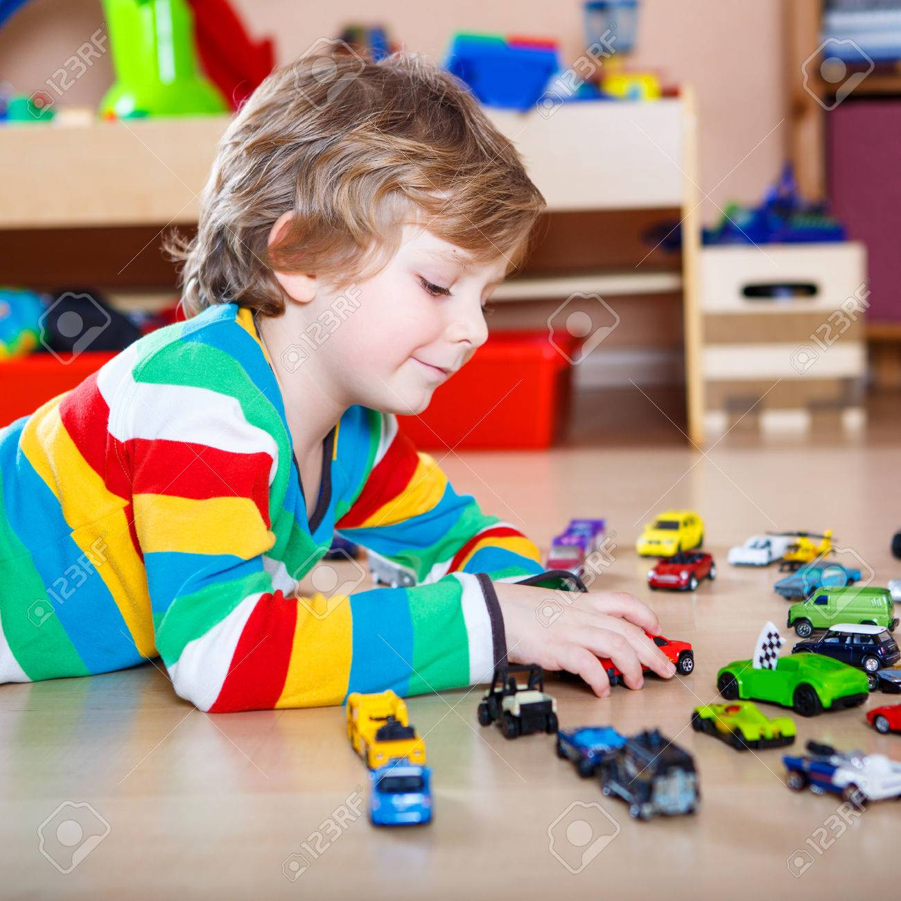
HOW TO USE WAS AND WERE IN ENGLISH?
He was disappointed with his result. In my childhood I was fascinated by toy cars.

Slide 17

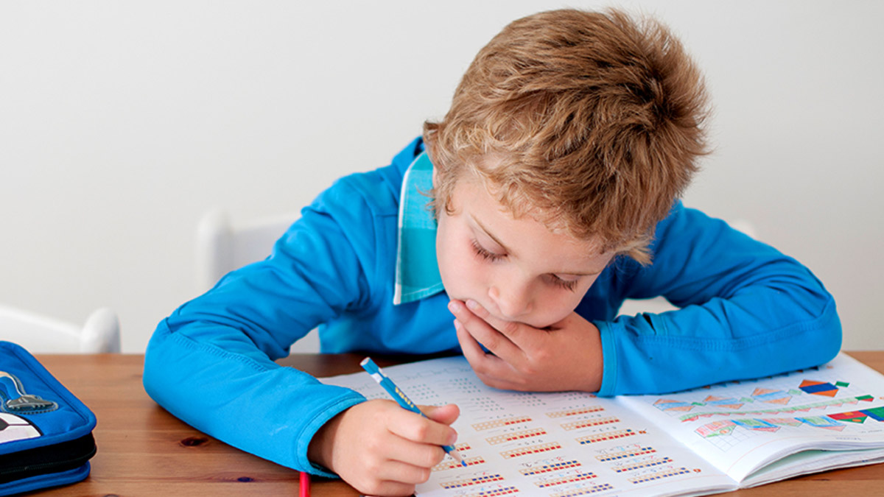
HOW TO USE WAS AND WERE IN ENGLISH?
Was and were are used with qualities of someone or something in the past.
She was very pretty as a child. He was good at math in school.

Slide 18
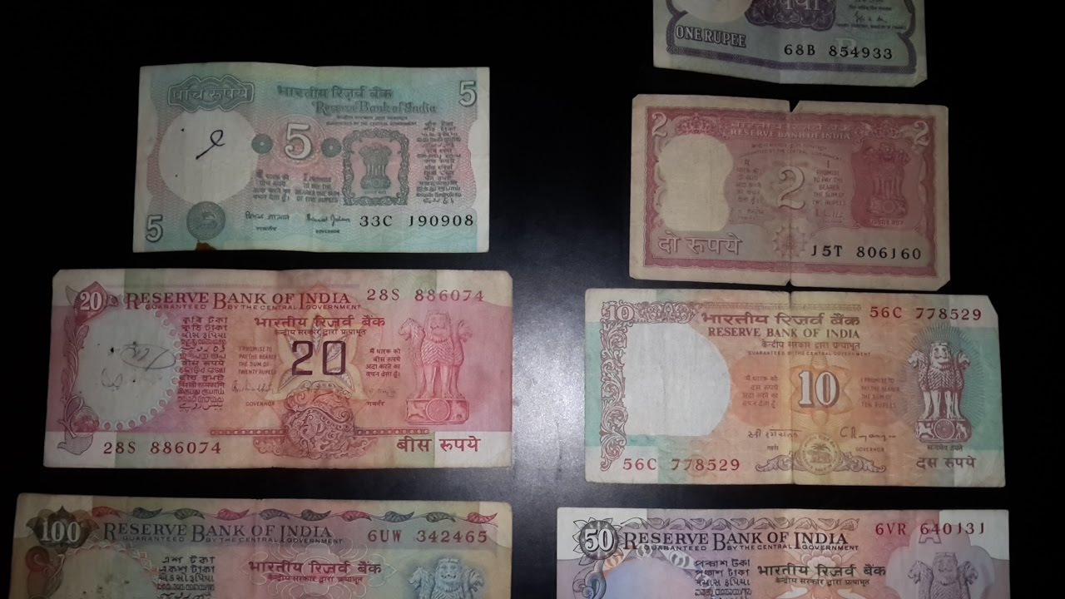
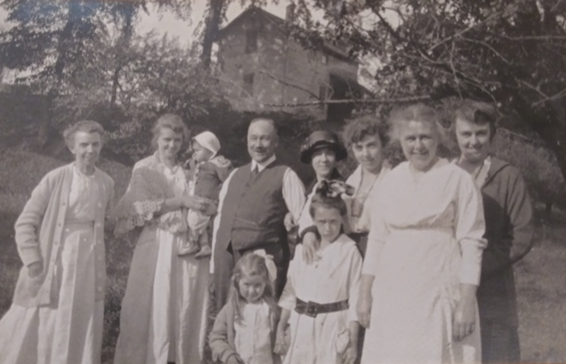
HOW TO USE WAS AND WERE IN ENGLISH?
Lifestyle was simple in the olden days. Cost of living was less in olden days.

Slide 19

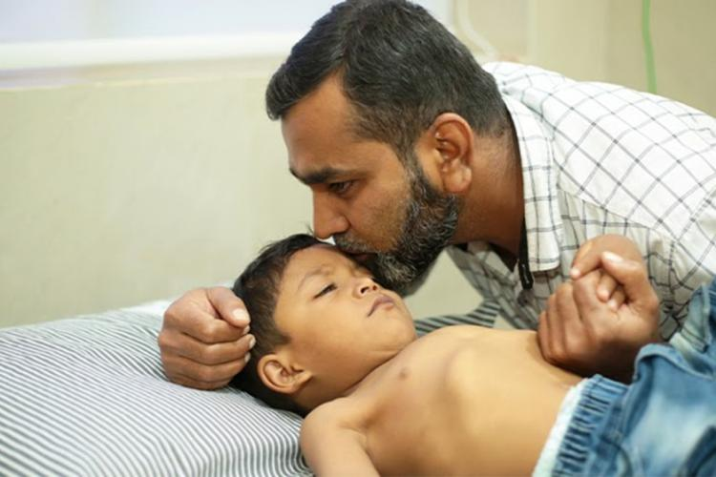
HOW TO USE WAS AND WERE IN ENGLISH?
He was active in his childhood. He was weak in his childhood.

Slide 20
HOW TO USE WAS AND WERE IN ENGLISH?
Was and were can be used with ing form of verbs only.
I was attending a class yesterday.
It was raining yesterday.
Yesterday I was watching the match.
We were studying for the exam yesterday.
The students were writing an exam at 9 am yesterday.
I was sleeping at this time yesterday.

Slide 21
WAS AND WERE-NEGATIVE & INTERROGATIVE FORM
We were at home. We were not at home. Were you at home?
I was free yesterday. I was not free yesterday. Were you free yesterday?
The books were available.The books were not available.Were the books available?
She was born in a village.She was not born in a village.Was she born in a village?
The movie was good. The movie was not good. Was the movie good?
The shops were open yesterday. The shops were not open yesterday.
Were the shops open yesterday?
The food at the wedding was tasty.
The food at the wedding was not tasty.
Was the food at the wedding tasty?

Slide 22
WAS AND WERE-NEGATIVE AND INTERROGATIVE FORM
We were sleeping at 11 pm.
We were not sleeping at 11pm.
Were you sleeping at 11pm?
The classes were interesting.
The classes were not interesting.
Were the classes interesting?
The students were attentive in class.
The students were not attentive class.
Were the students attentive in class?

